Slide 1

introduction to mathematical software & programming (IMSP)
Preliminary course information – 2022
Lecture 0
12 February 2022

Slide 2
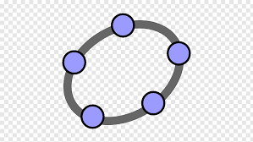


Welcome!!
Welcome to CELEN087. In this module we will learn some
basic programming skills from three different packages:
GEOGEBRA (Version 6)
LaTeX
MATLAB (2021a)
For more detail, please consult the module handbook on Moodle.

Slide 3
workload
11 lectures (1/wk) on Thursdays, 2-3pm, DB-A05
5 bi-weekly computer labs (~ 3hrs long), PB226
4 in-lab written quizzes each worth 10%
Mid-term test on Wednesday 13 April 2022 worth 20%
In-lab practical (programming) final exam worth 40%

Slide 4
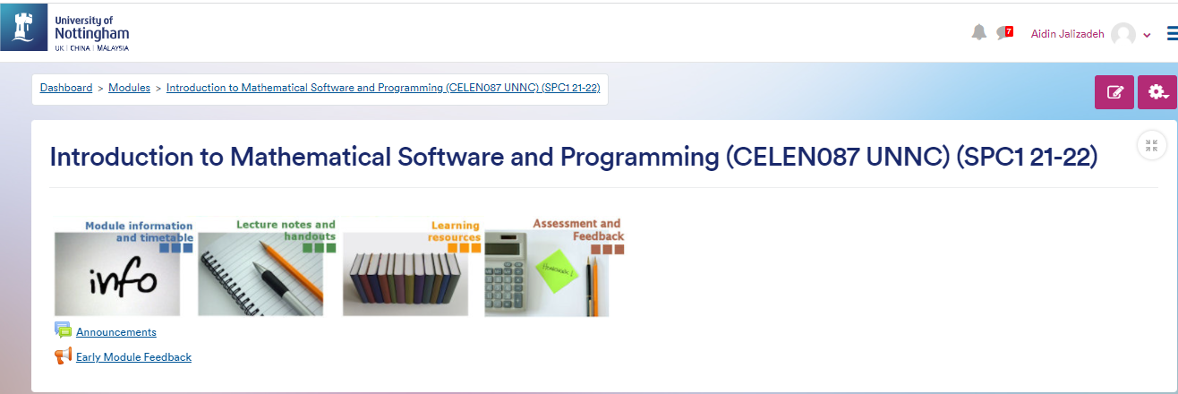
moodle
It is your absolute responsibility to check
the module’s Moodle page on a daily basis for
any updates and announcements!
Link: https://moodle.nottingham.ac.uk/course/view.php?id=124422#mod-tabbedcontent-content36225

Slide 5
Good luck to you all!

